Slide 1
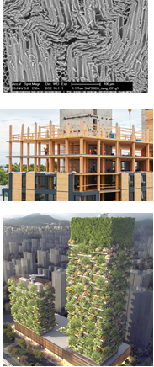
Biobased Structures and Materials
Steel and Timber structures

Slide 2
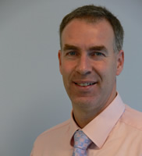
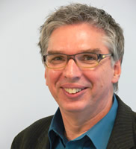

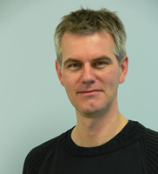
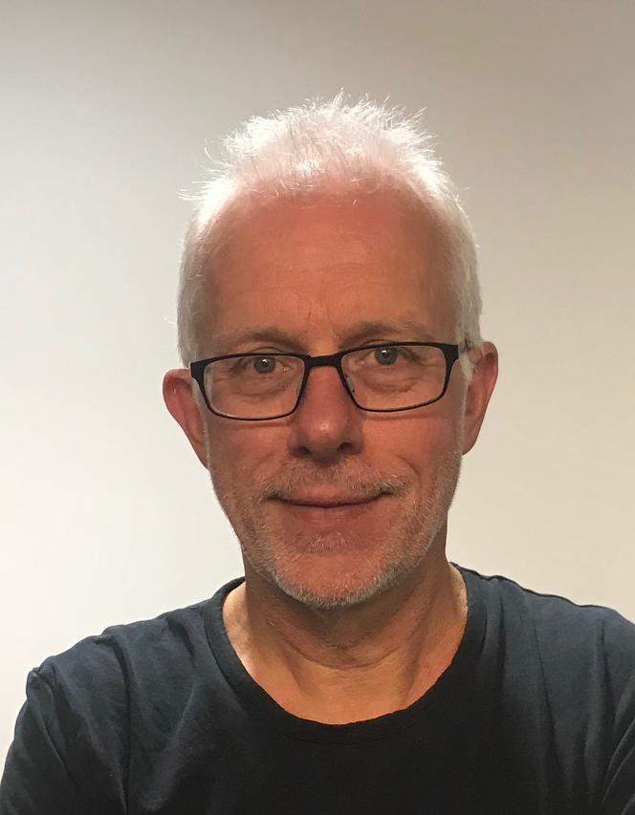


Biobased Structures and Materials
Focus
Sustainable structures and buildings
Design of structures with renewable materials:
Timber, Bamboo, Fibres, Bioplastics, Asphalt and Concrete with Biofibres
Biobased Circular Economy
Capture of carbon (carbon sinks)
1 m³ of wood ≈1 ton of CO₂ captured
Jan-Willem van de Kuilen
Wolfgang Gard
Courses:
CIE 4110 Timber Structures and Wood Technology
CIE 5124 Biobased Structures and Materials
Geert Ravenshorst
Michele Mirra
PhD student
CIE 5131 Fire Safety Engineering
CIE 4125 Structural Design Case
Abhijith Kamath
PhD student
Xiuli Wang PhD student
Peter de Vries

Slide 3
Biobased Structures and Materials
Steel and Timber structures
Materials properties and connections
Structural design and engineering
Building with nature
Existing structures and cultural heritage

Slide 4
Materials´ properties and connections
Steel and Timber structures
Wood, Bamboo, Palm trees
Fibres and chemicals for biobased asphalt and concrete
Mechanical properties of connections
Strength and fatigue models

Slide 5
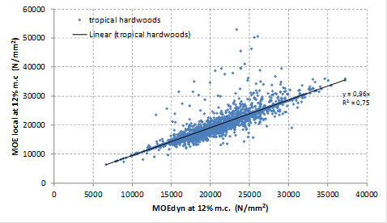
Mechanical properties and connections
Steel and Timber structures
Wood material strength models
Non-destructive measurements to predict engineering properties

Slide 6
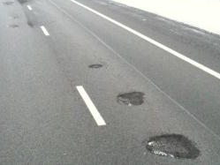



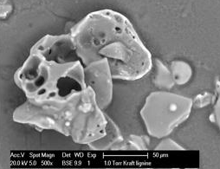
Fibres and chemicals for biobased asphalt and concrete
Steel and Timber structures
Flow test after 24 hours: BR bitumen, BL5 (5% lignin), BL10 (10%), BWD (wood fibres)

Slide 7
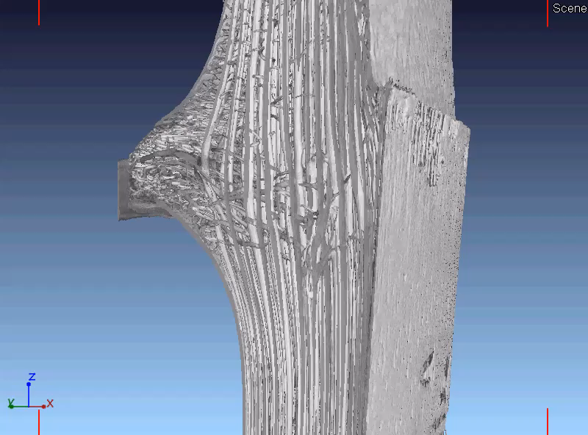
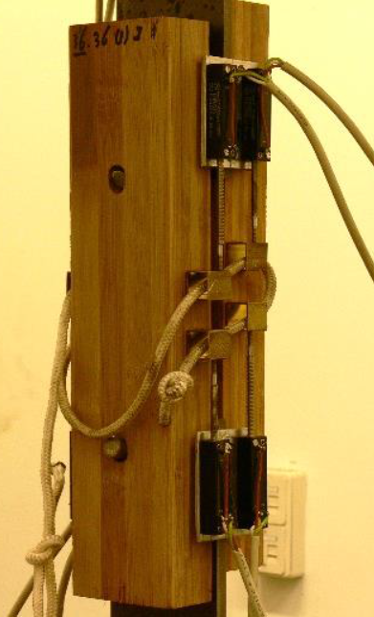
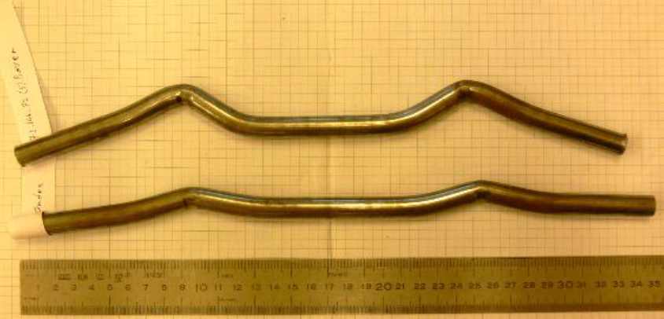
Biobased Structures and Materials
Steel and Timber structures
Connections with bamboo.
Analysis of failure modes with VHSS and UHSS - Very / Ultra High Strength Steels

Slide 8
Structural design and engineering
Steel and Timber structures
Hydraulic structures / Bridges / Road structures
Multi-storey timber buildings
Service life modelling
Earthquakes
Fatigue models

Slide 9
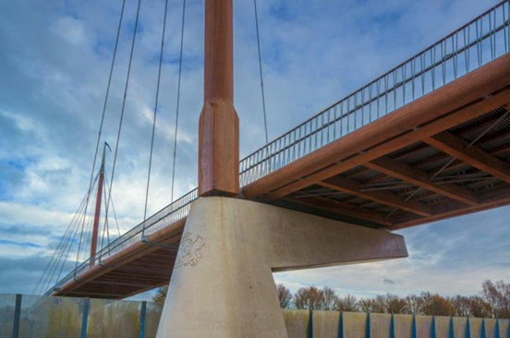
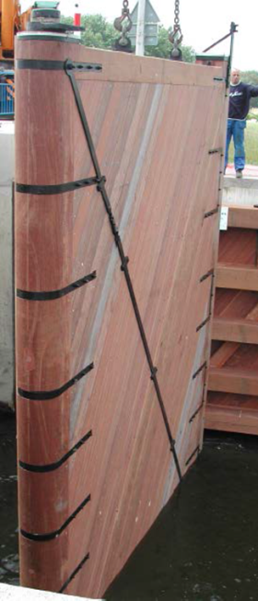
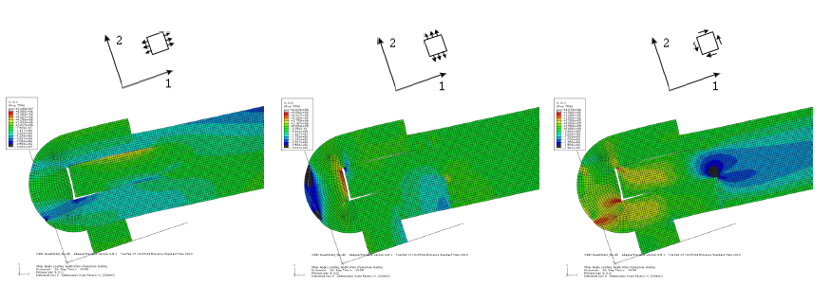
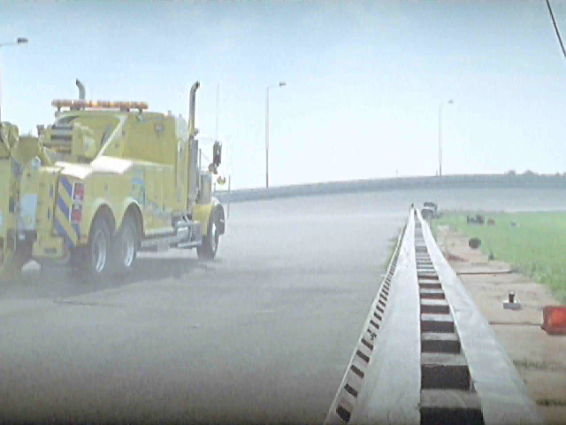
Steel and Timber structures
Hydraulic works / Bridges / Road structures
Tropical hardwoods high strength and durability.
Mechanical properties +
(Non-) destructive testing
FEM-Modelling

Slide 10
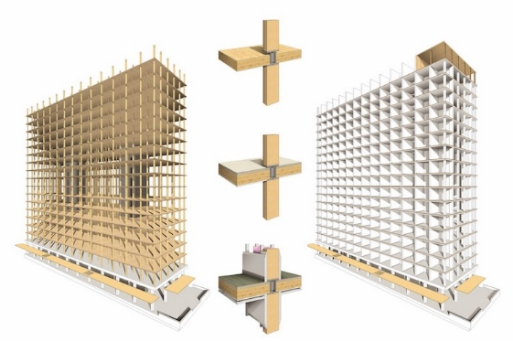
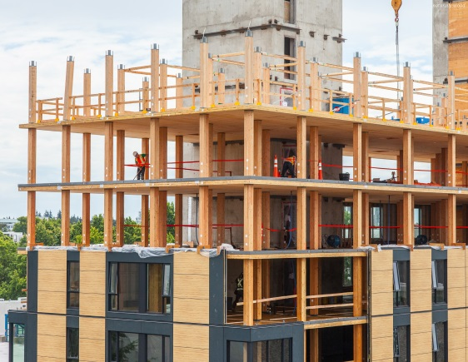
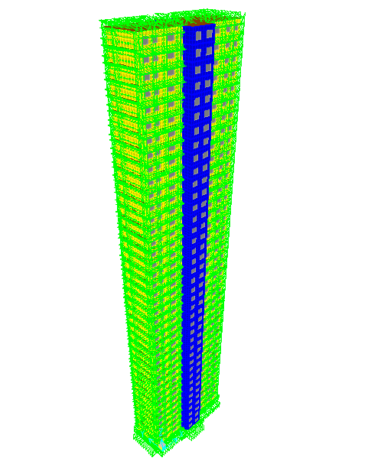
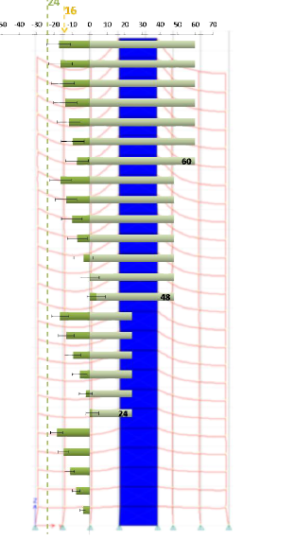
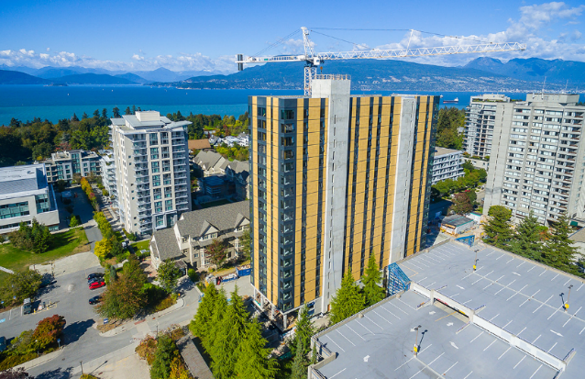
High-rise buildings using biomaterials
Steel and Timber structures
Structural behaviour earthquake + wind
Phased analysis of vertical differential settlements

Slide 11
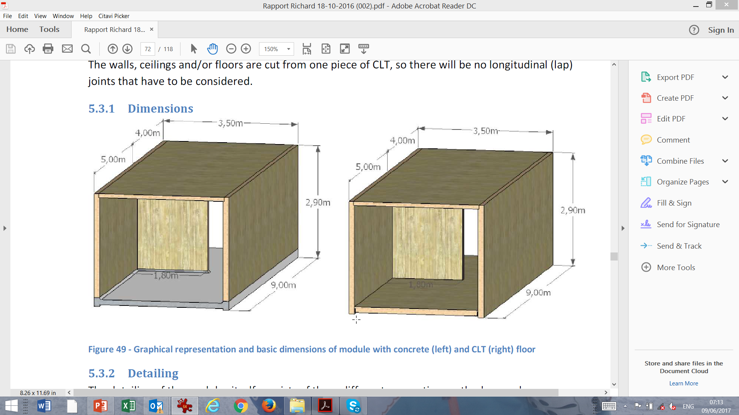
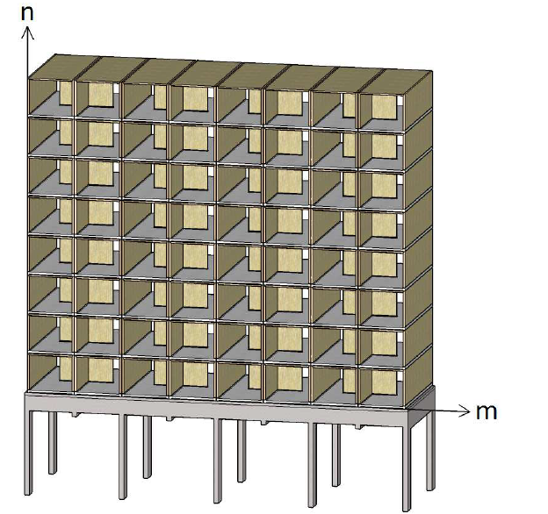
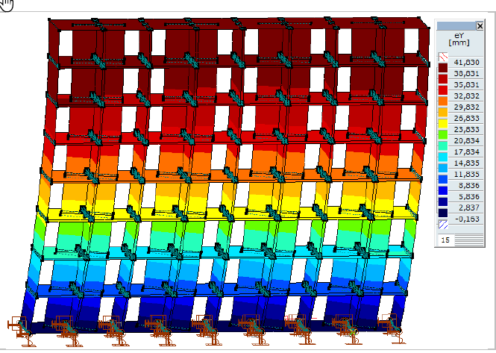
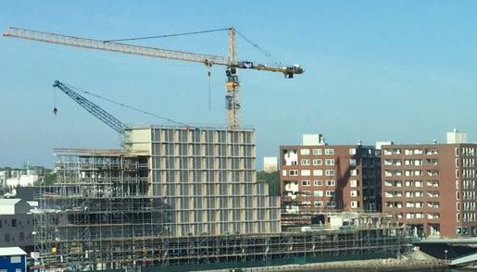
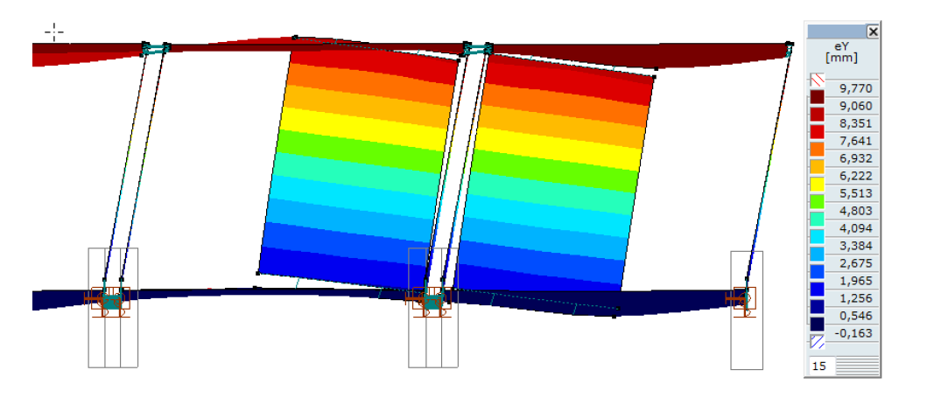
Steel and Timber structures
High-rise buildings using biomaterials
Hotel Jakarta in Amsterdam

Slide 12
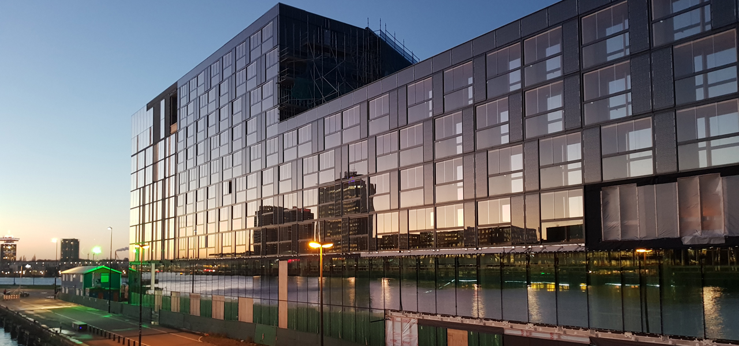
Steel and Timber structures
High-rise buildings using biomaterials
Hotel Jakarta in Amsterdam. Open since June 2018!

Slide 13
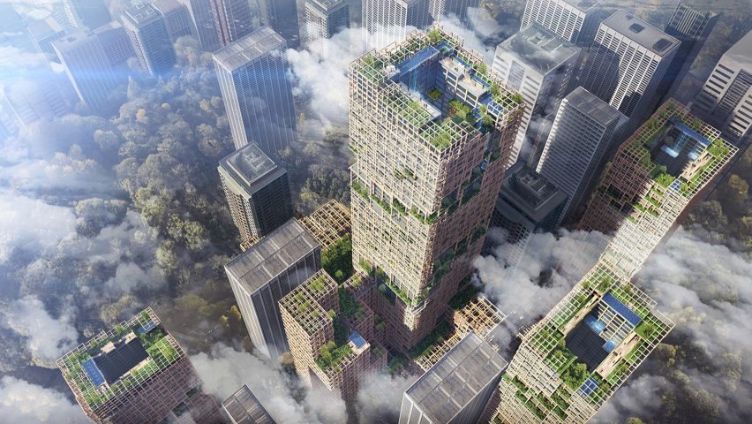
High-rise buildings using biomaterials
Steel and Timber structures
challenge
A 350 metre high wooden skyscraper is being planned by the Sumitomo Forestry for Tokyo

Slide 14
Building with nature
Steel and Timber structures
2 examples
Hydraulic ´structures´ with tree-root-soil interactions
Vertical forests

Slide 15
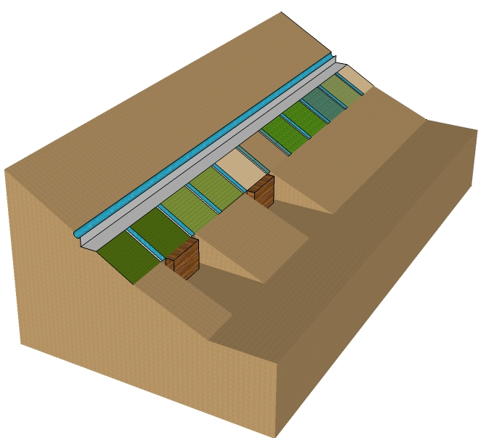
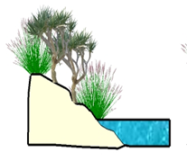
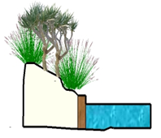
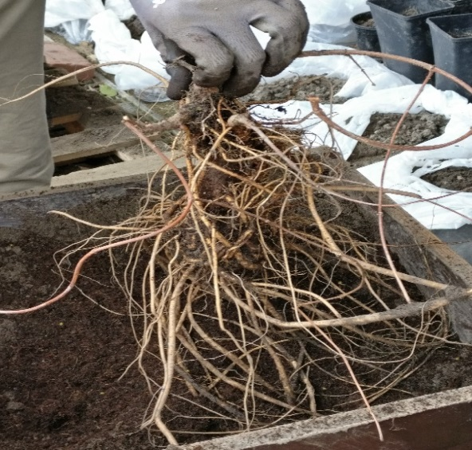
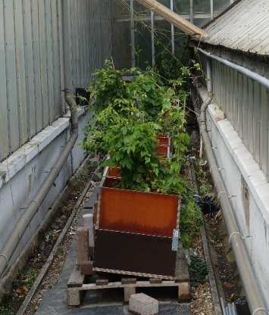
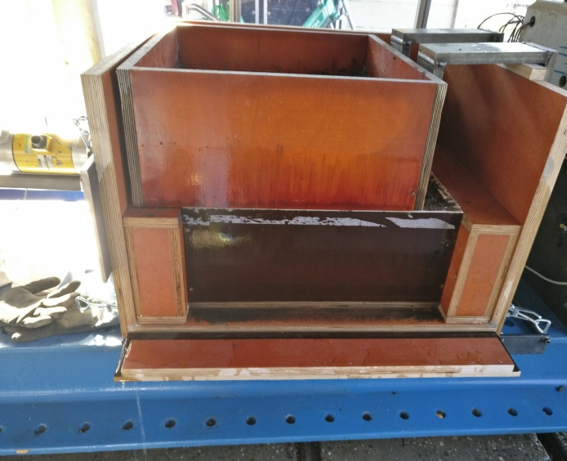
Steel and Timber structures
Hydraulic ´structures´ with tree-root-soil interactions
Embankment
Root characterization
Plants grown in shear boxes
Direct shear tests

Slide 16
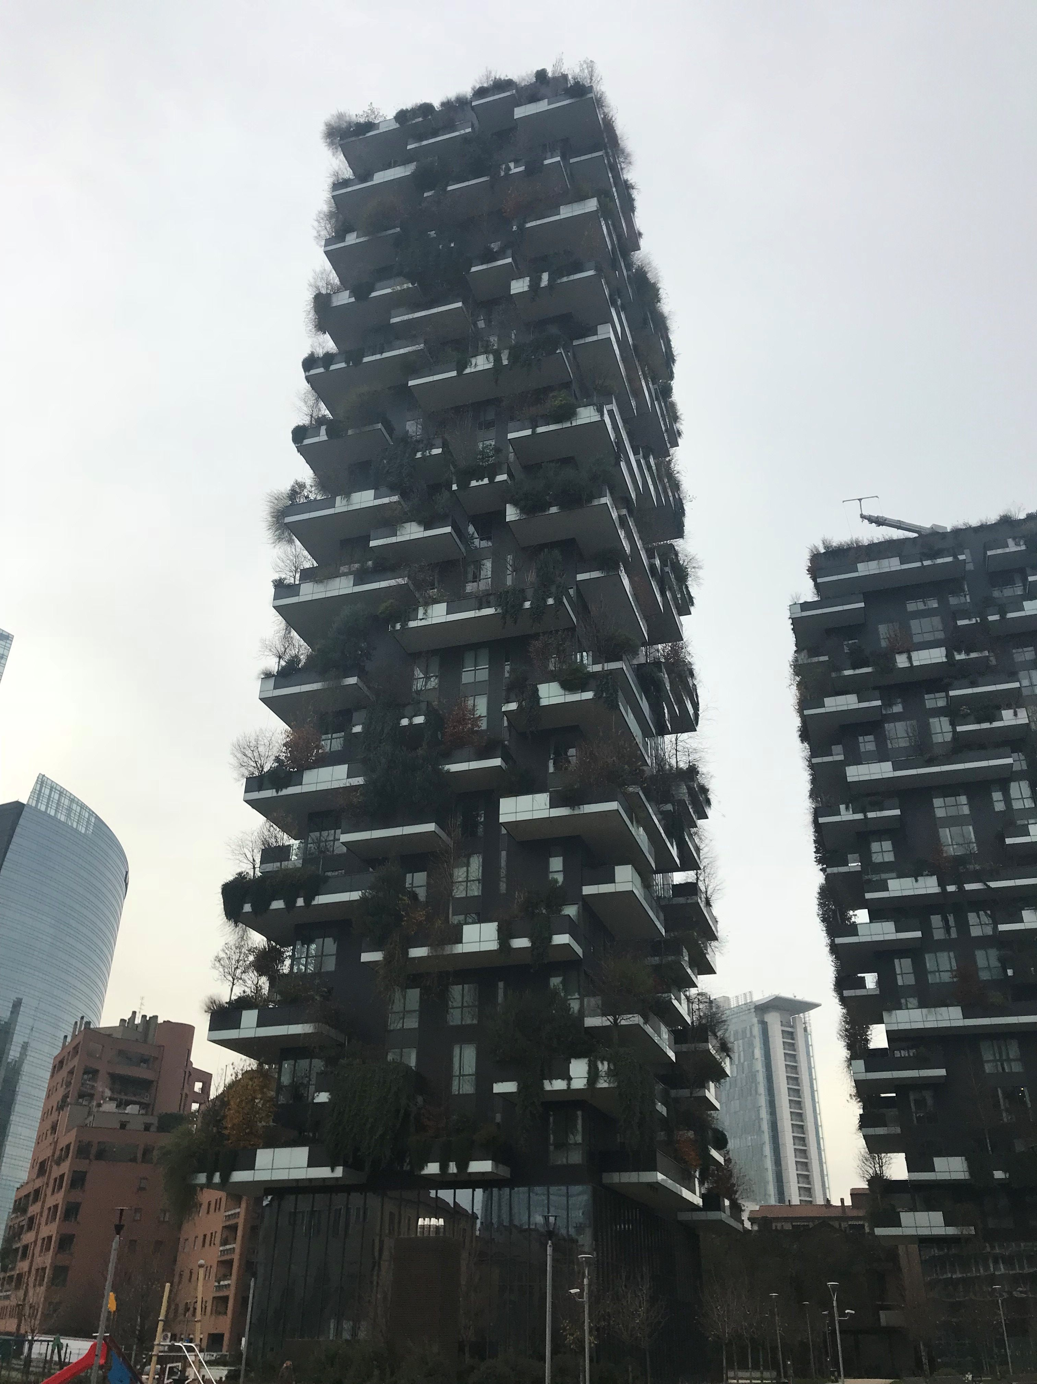
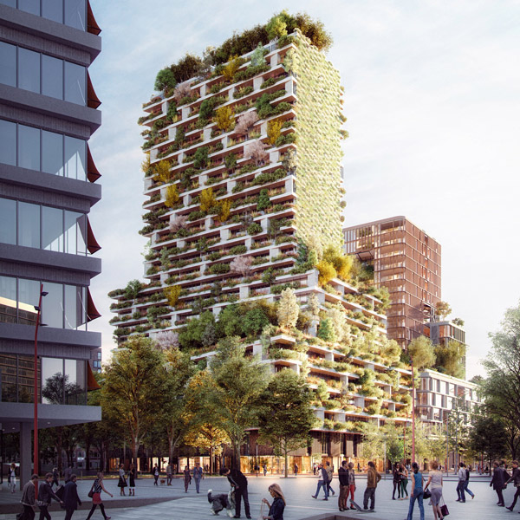
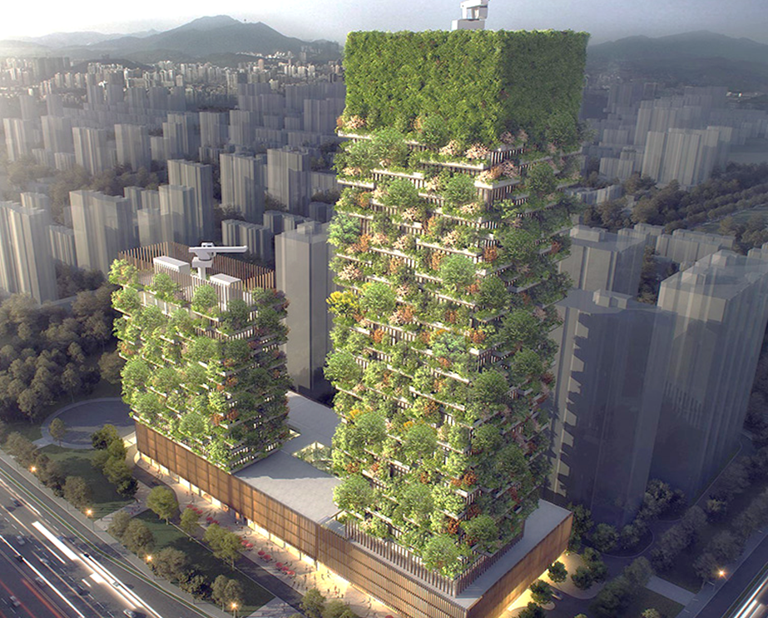
Vertical forests
Steel and Timber structures
Case study, China
Utrecht, NL
Buildings in the design stage at Eindhoven, Singapore, Lausanne….
Milan, Italy
Boeri Architects

Slide 17
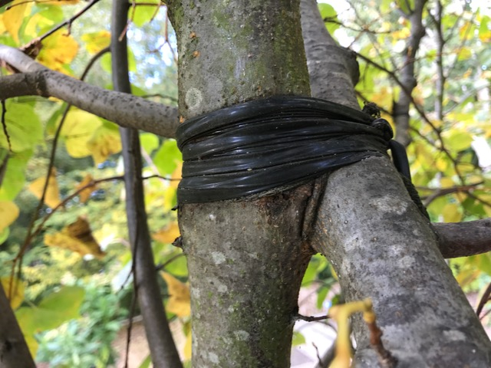
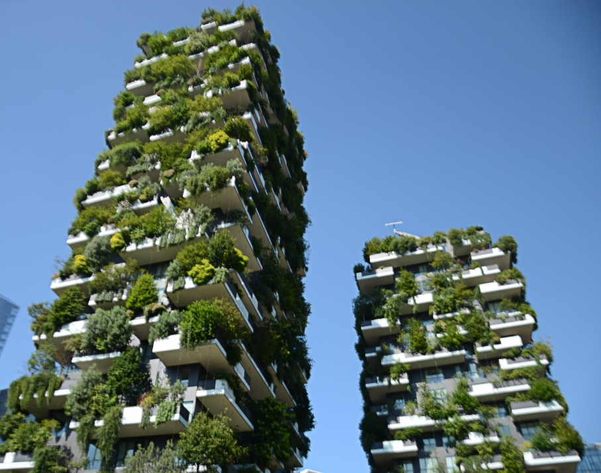
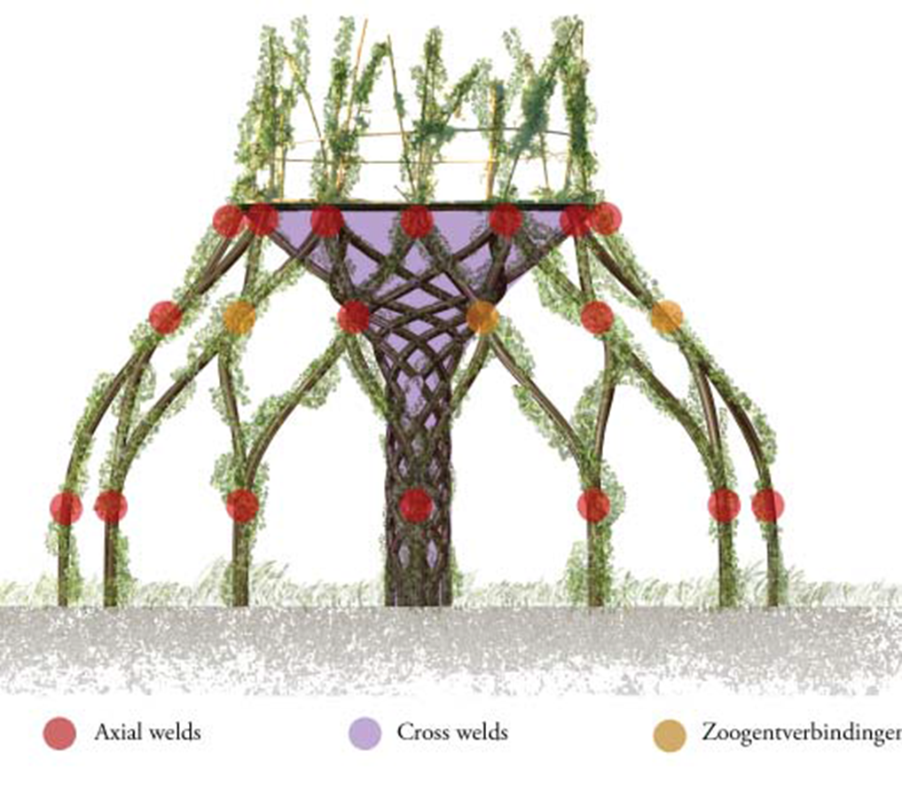
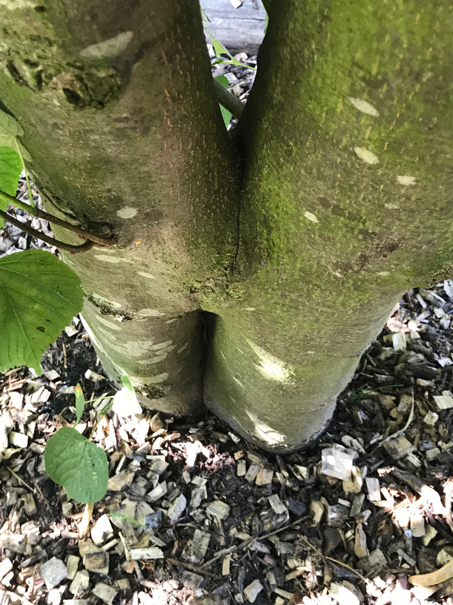
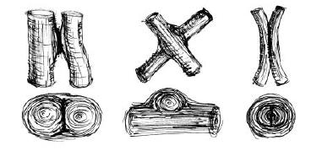
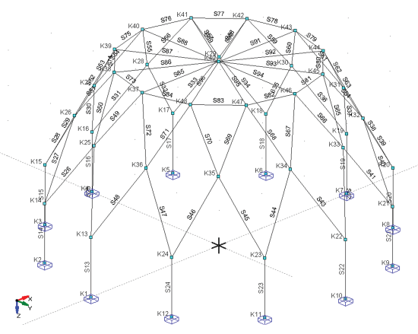
Self growing structures
Steel and Timber structures
Tree nodes
Botanical Garden - TU Delft
Real node

Slide 18
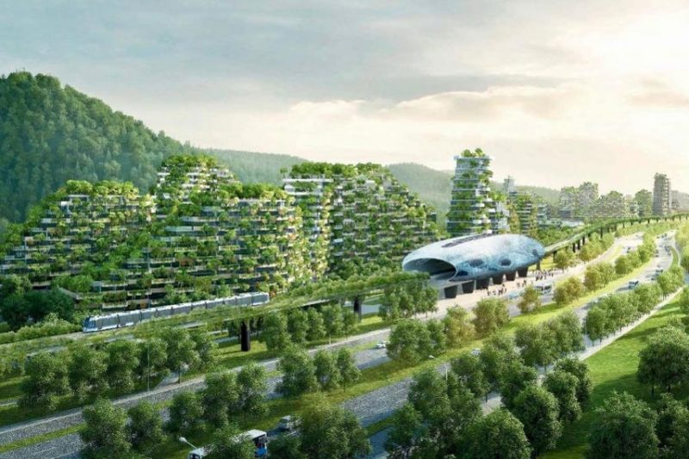
The future of cities…
Steel and Timber structures

