Slide 1
Concrete Structures
Concrete structures
Your future specialization?

Slide 2
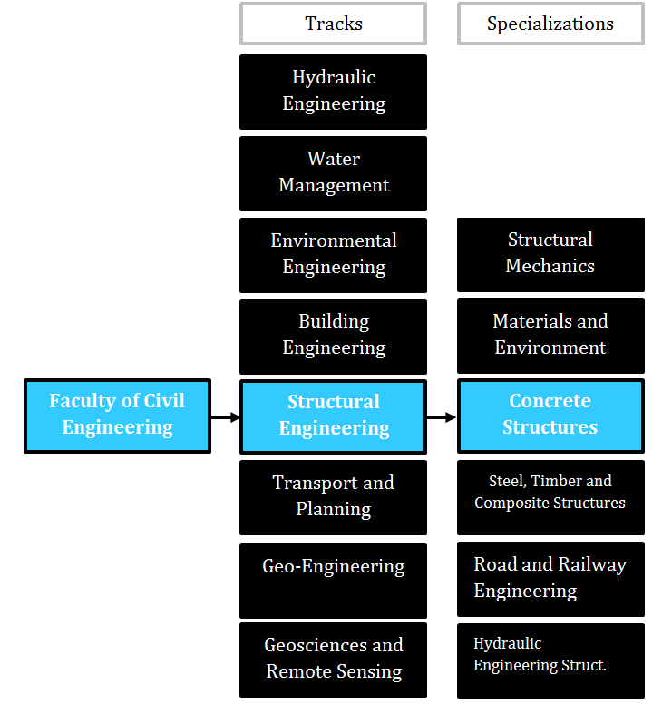
Where are you?
Concrete structures

Slide 3
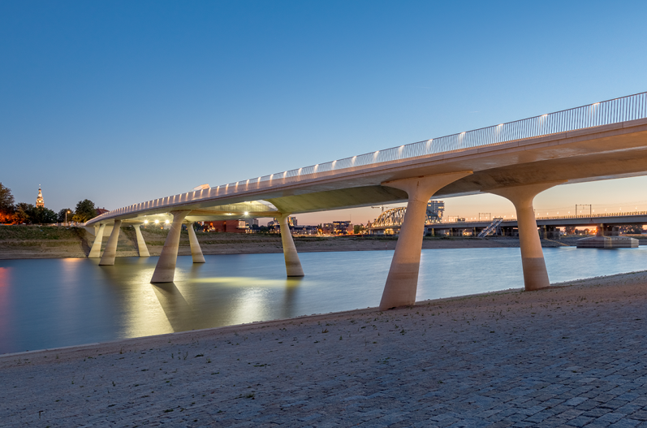
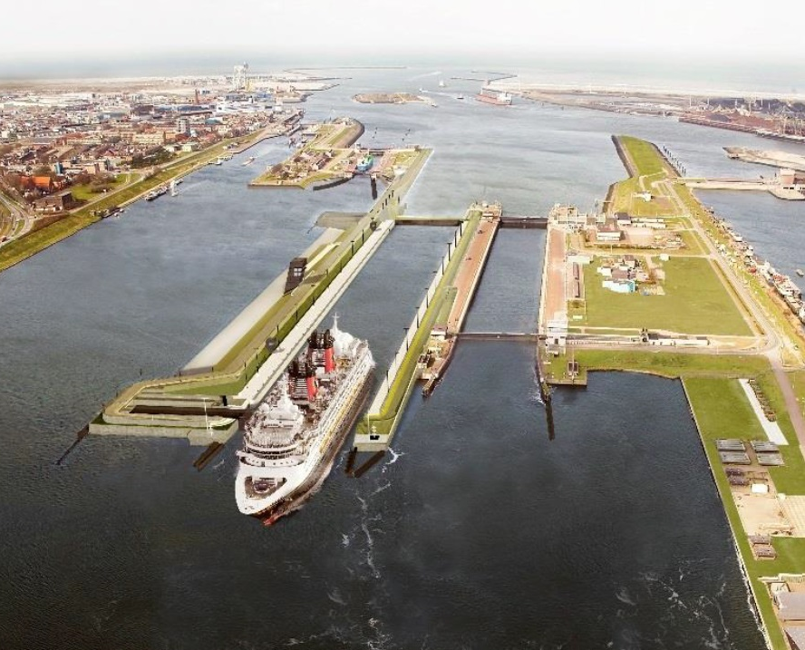
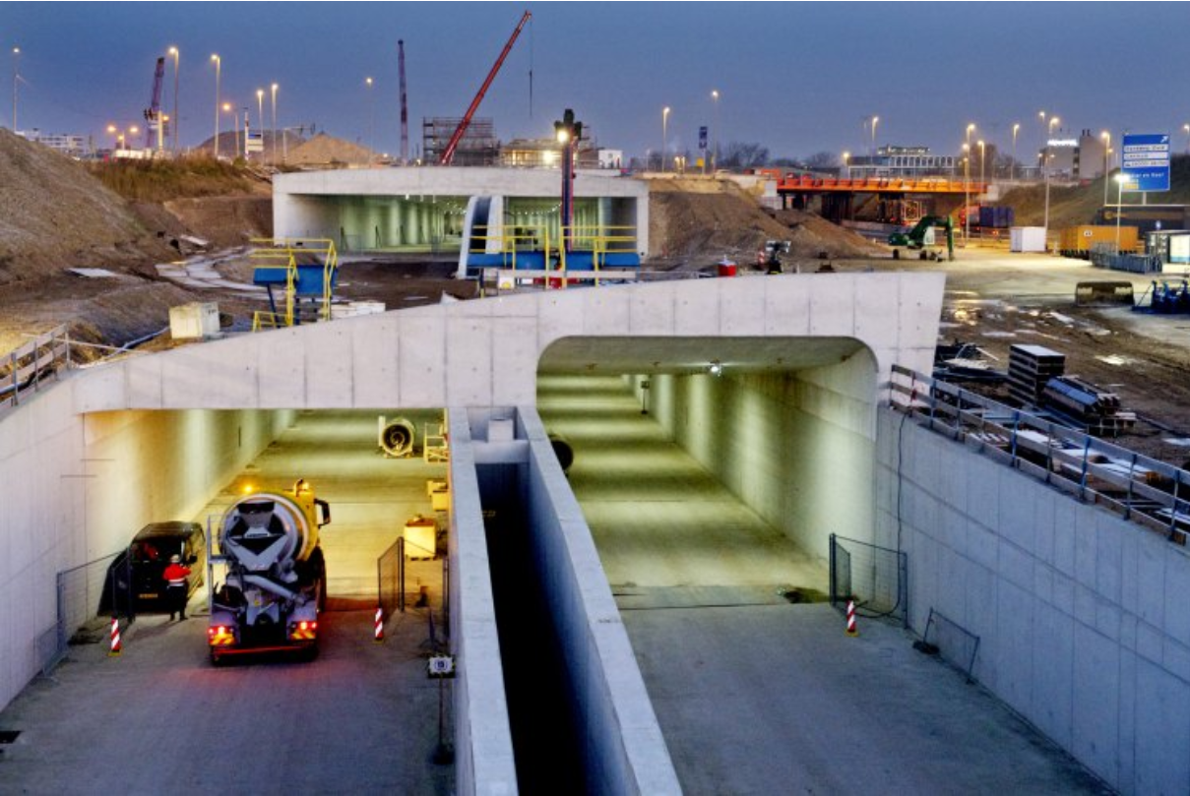
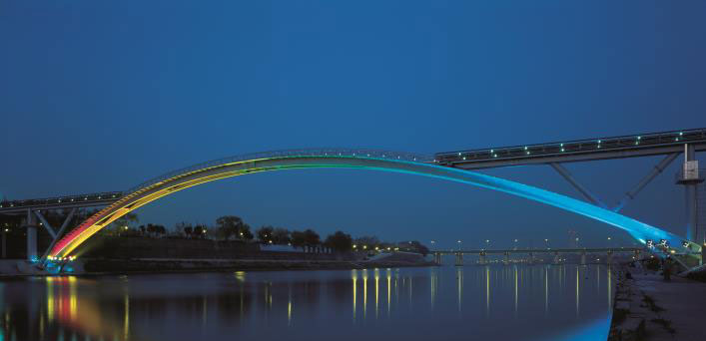
Why would you choose Concrete Structures???
Concrete structures

Slide 4
Why would you choose Concrete Structures???
Concrete structures
What to expect?

Slide 5
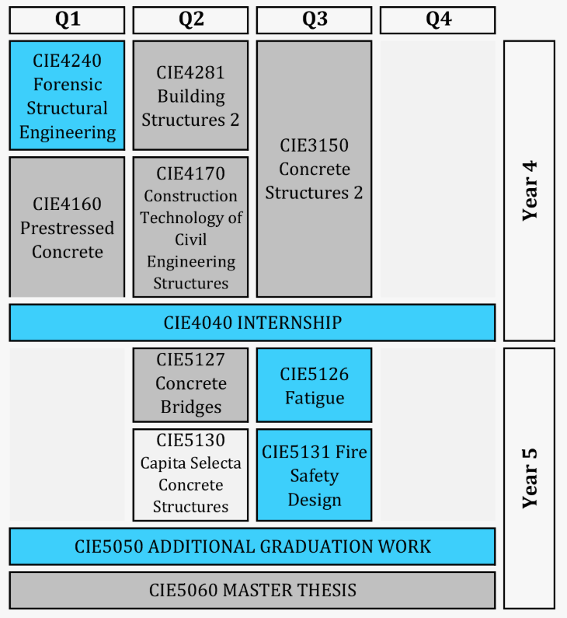
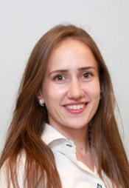
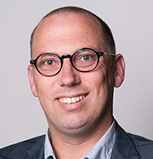
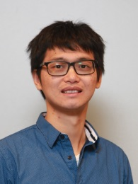
MSc courses
Concrete structures
Teachers
…but they are not only teachers
link with practice

Slide 6
Concrete structures
Why would you choose Concrete Structures???
What is your perspective?

Slide 7
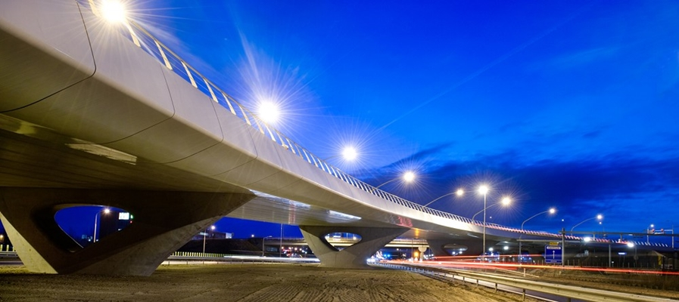
Be a designer
Concrete structures
Flyover Harlem

Slide 8
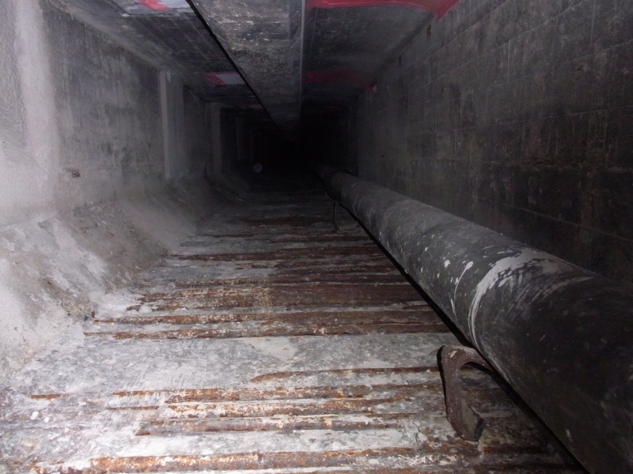
Be an advisor
Concrete structures
Maastunnel Rotterdam

Slide 9
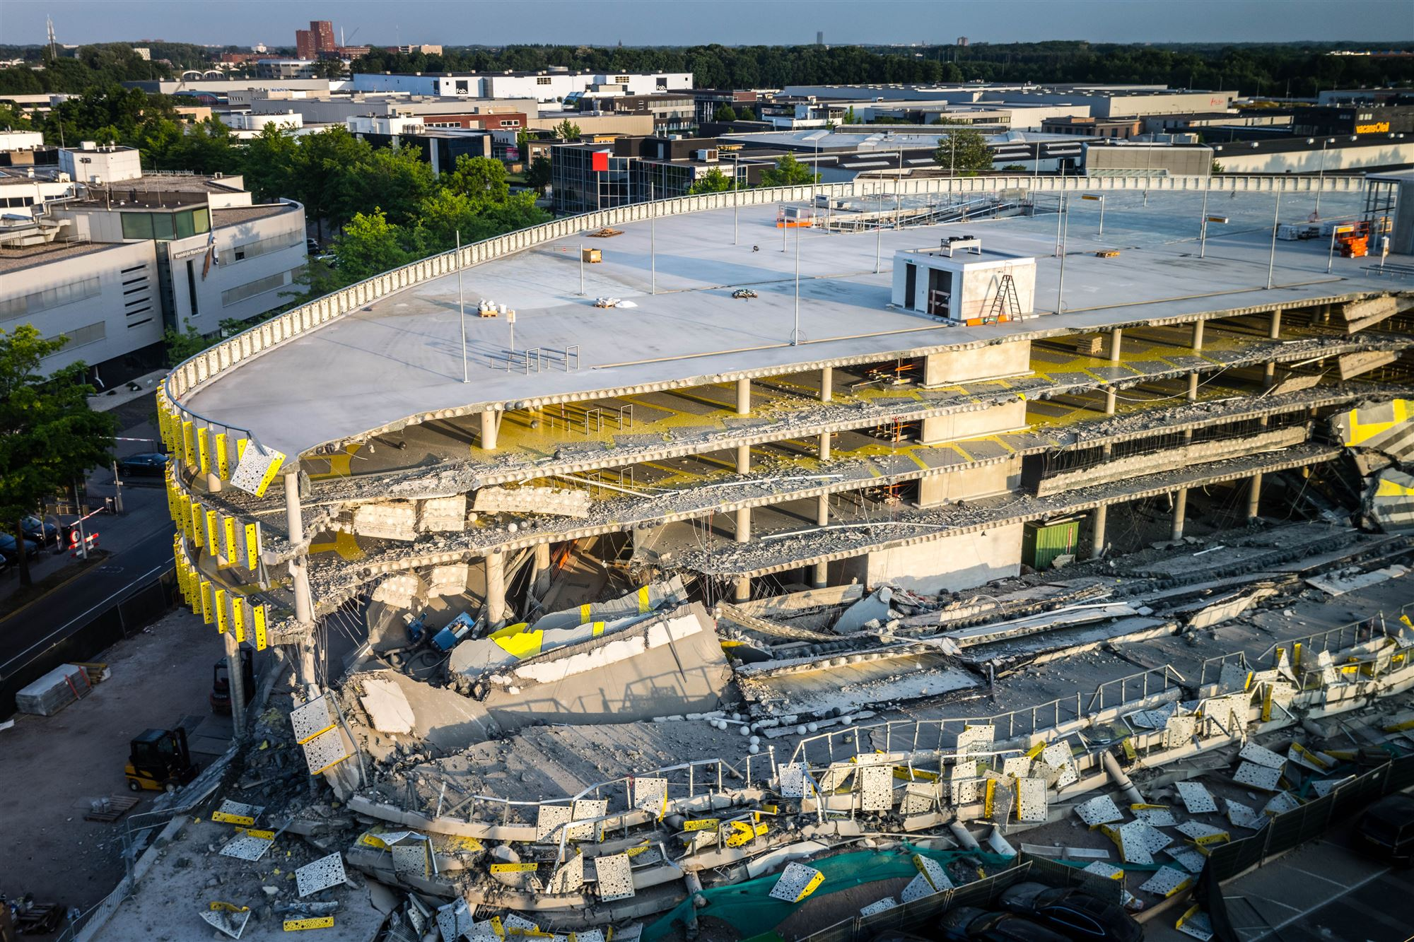
Be a forensic engineer
Concrete structures
Eindhoven Airport 27-5-2017

Slide 10
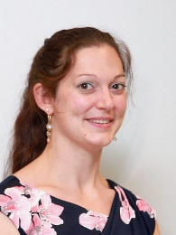
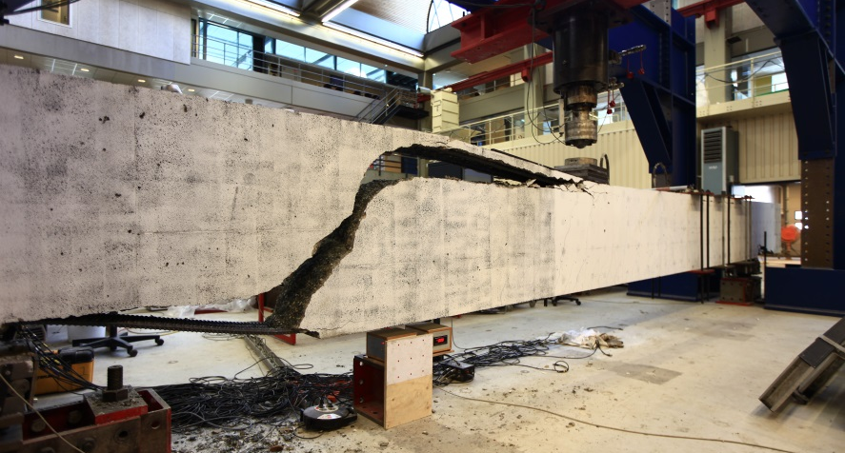
Be a code developer
Concrete structures
Is the structure safe?

Slide 11
Why would you choose Concrete Structures???
Concrete structures
Do we know everything about concrete structures?

Slide 12
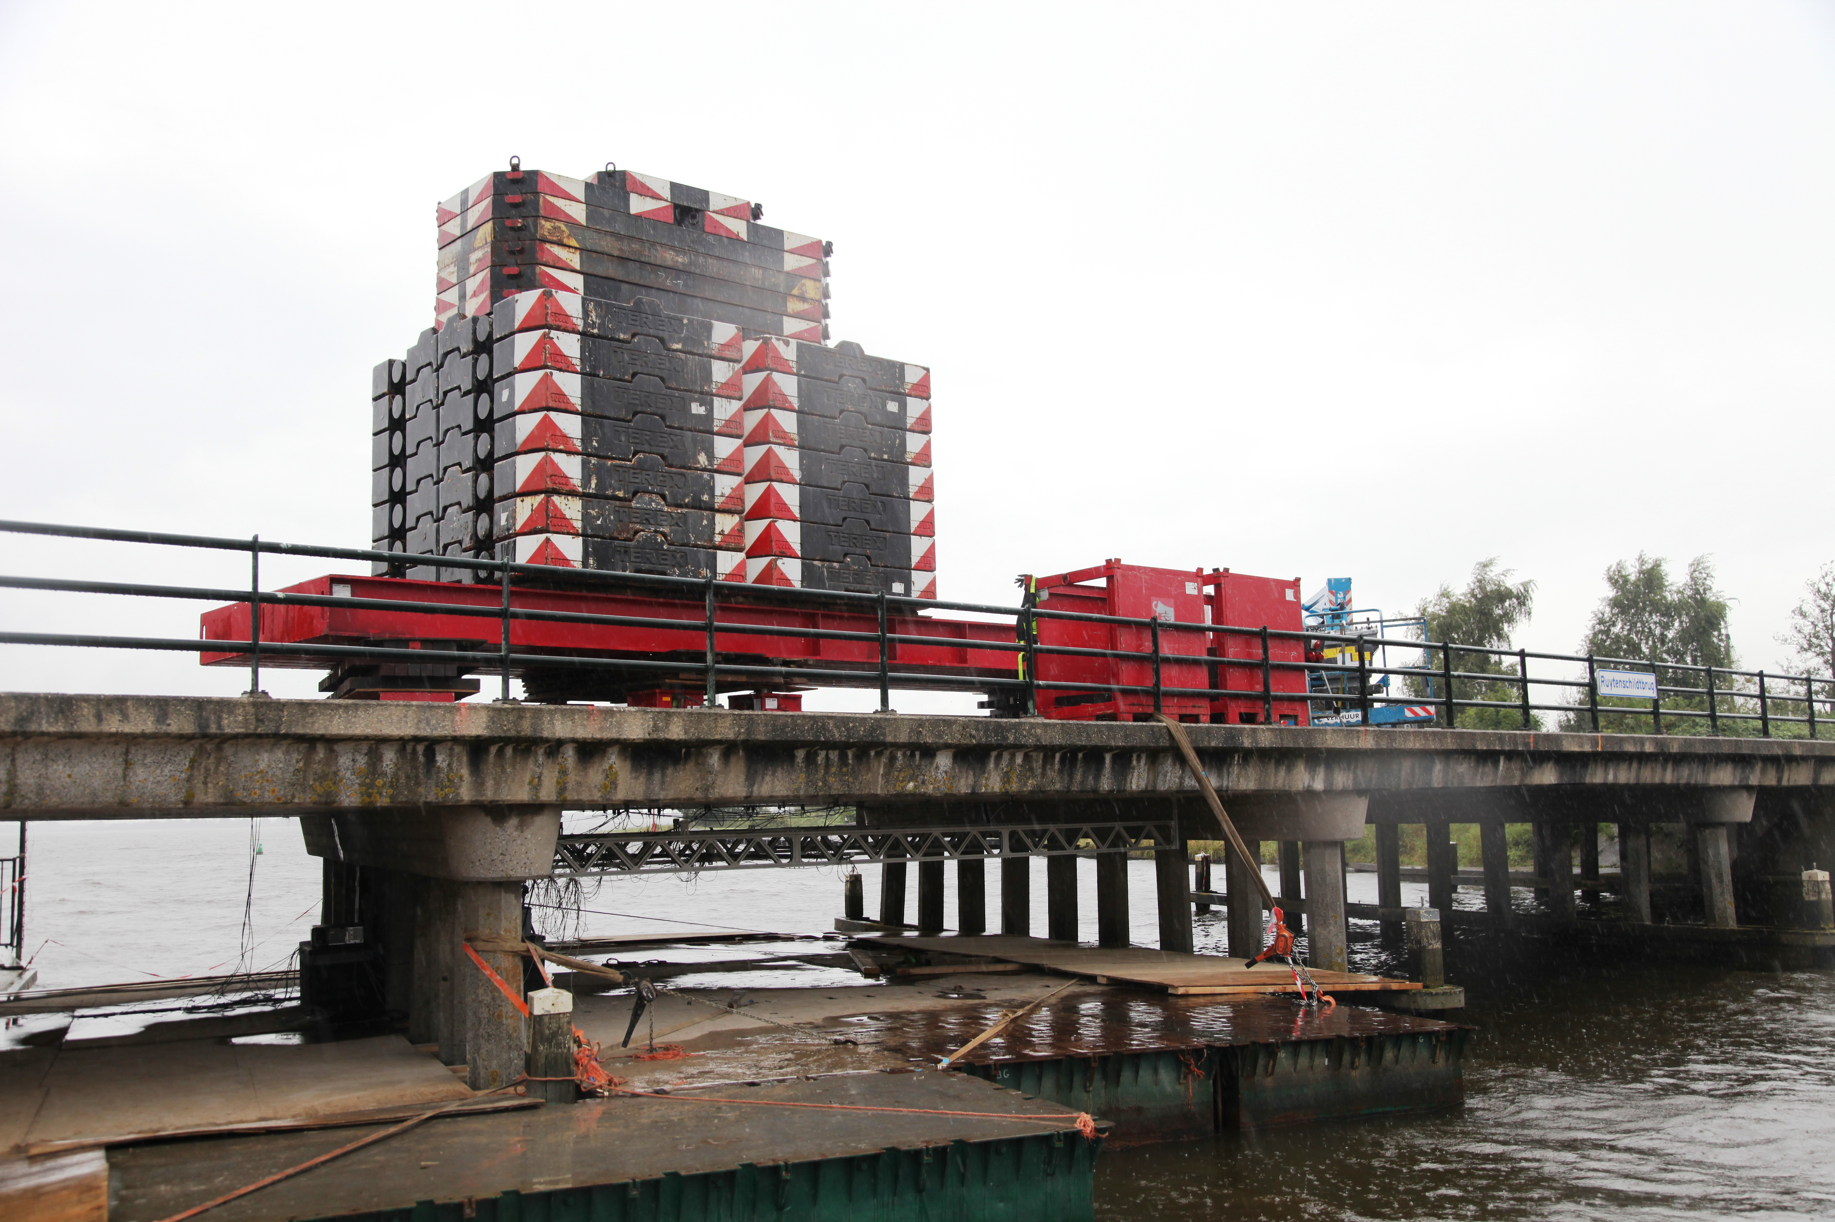
Three research lines
Concrete structures
Assessment of existing structures

Slide 13
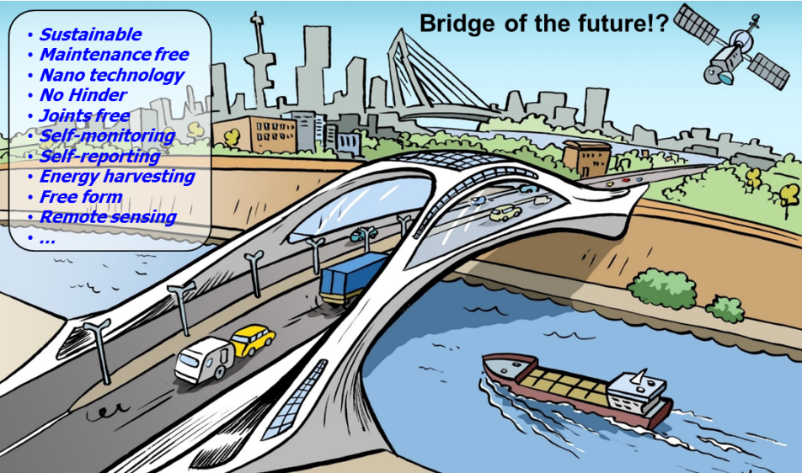
Three research lines
Concrete structures
Upscaling new concrete types

Slide 14
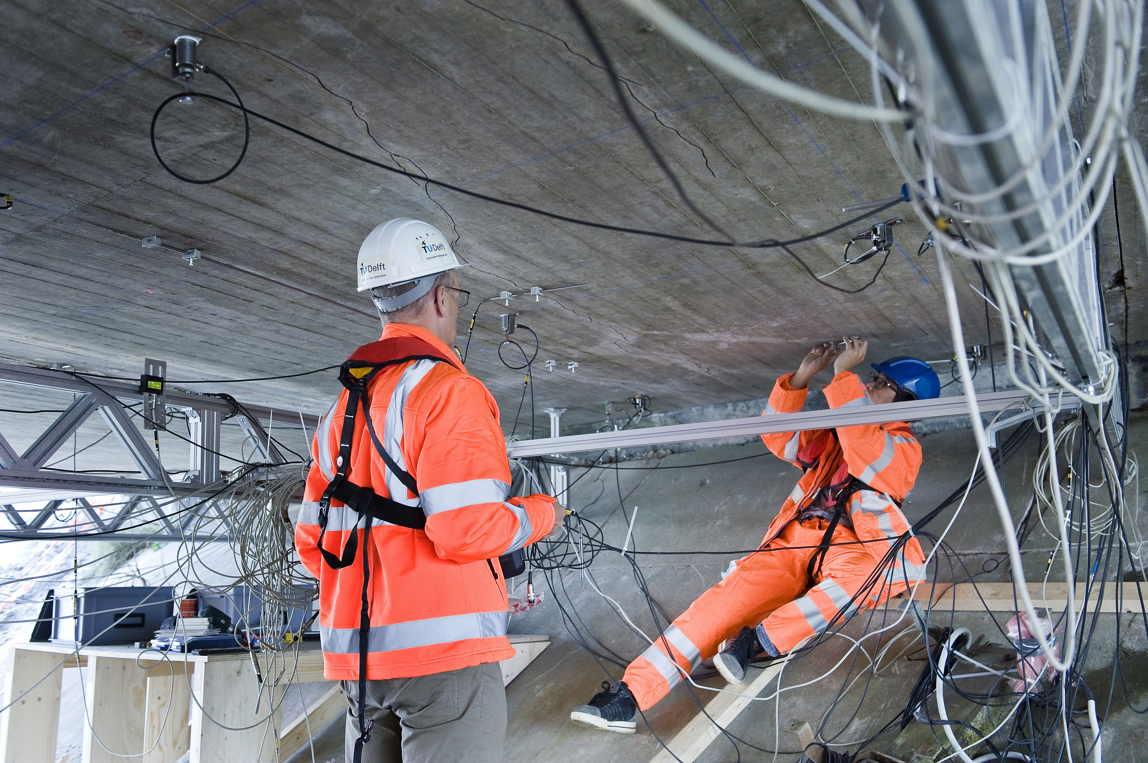
Three research lines
Concrete structures
Monitoring

Slide 15
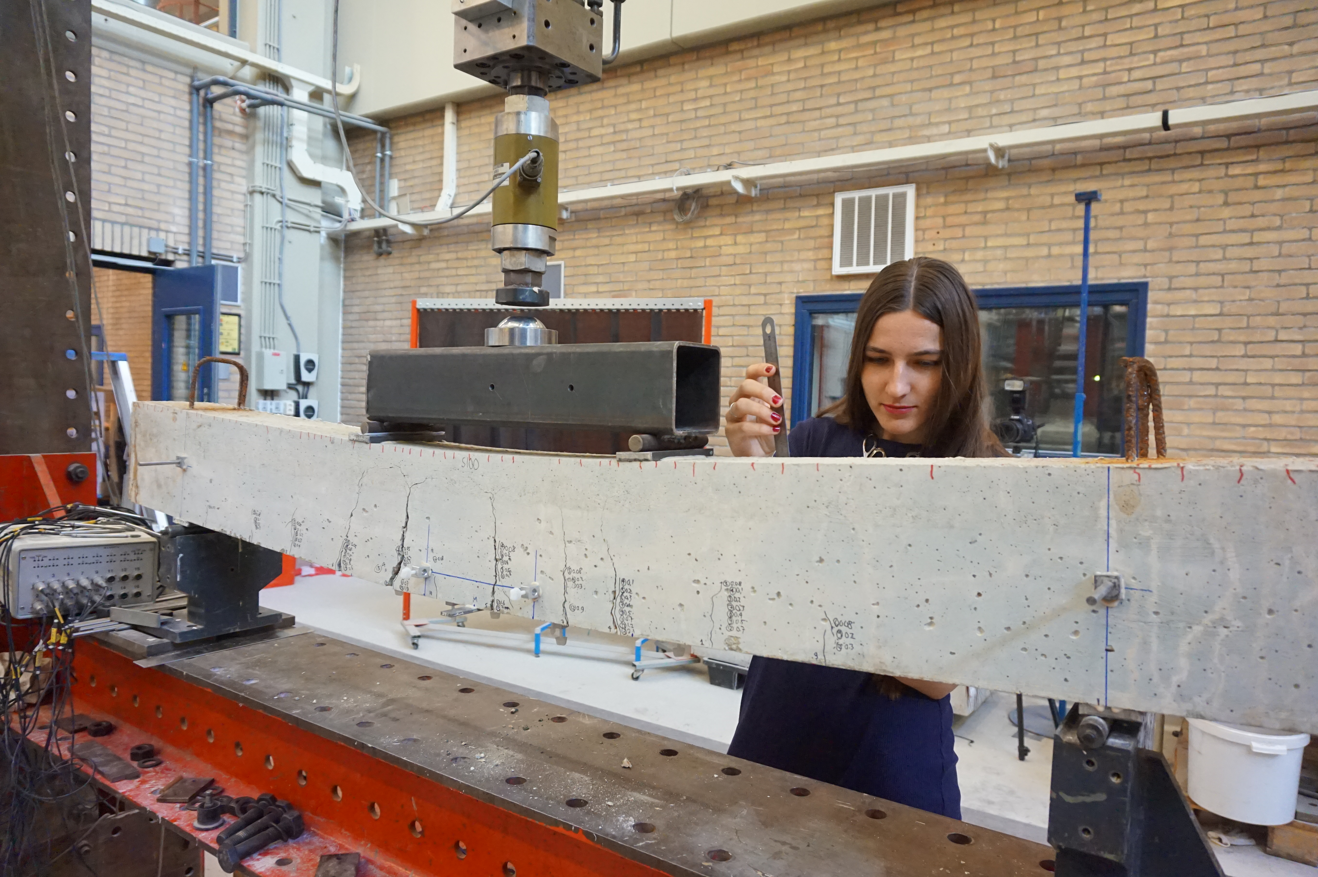
Why would you choose Concrete Structures???
Concrete structures
Your MSc thesis can help fill the gaps in knowledge
…experiments
…modelling
…design

Slide 16
More information? https://www.tudelft.nl/en/ceg/about-faculty/departments/engineering-structures/sections-labs/concrete-structures/
Concrete structures

Slide 17
More information? https://www.tudelft.nl/en/ceg/about-faculty/departments/engineering-structures/sections-labs/concrete-structures/
Concrete structures

