Slide 1
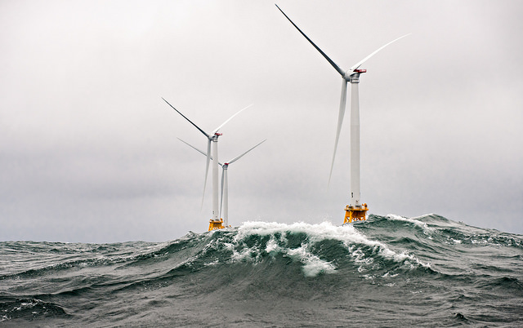
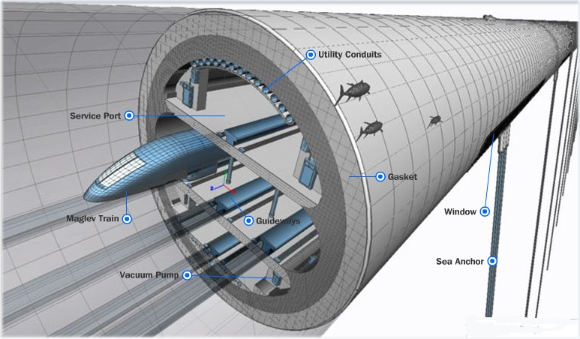
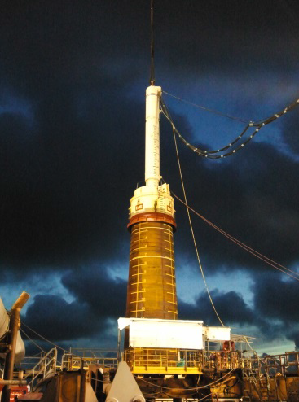
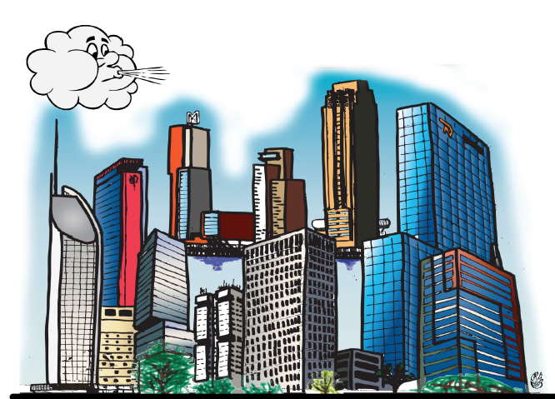
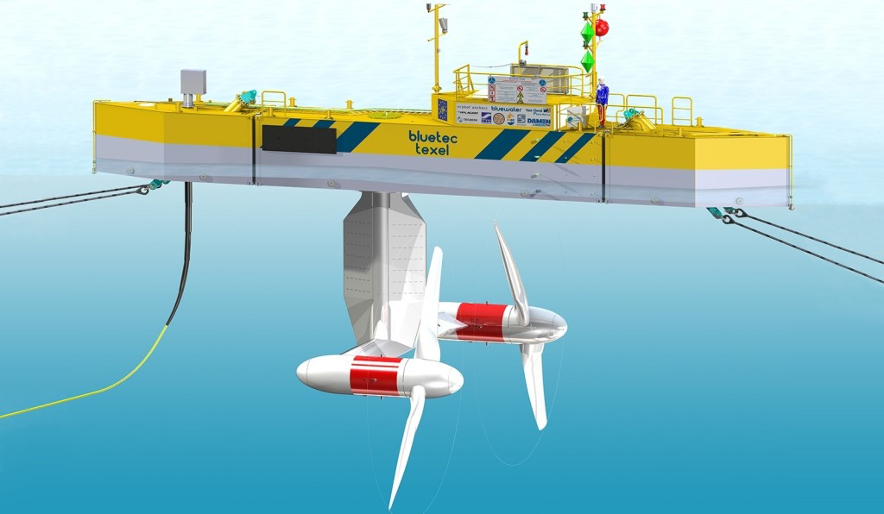
Structural mechanics
Section Dynamics of Structures

Slide 2
Structural mechanics
Dynamics of Structures
Mission of the chair
Educate Structural Engineers who will be in high demand at the companies focusing on design, installation, monitoring and operation of structures subjected to dynamic loads.

Slide 3
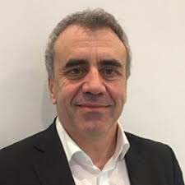
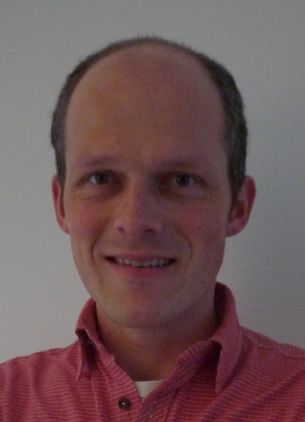
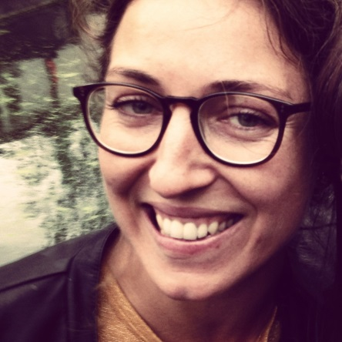
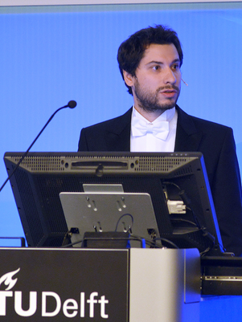
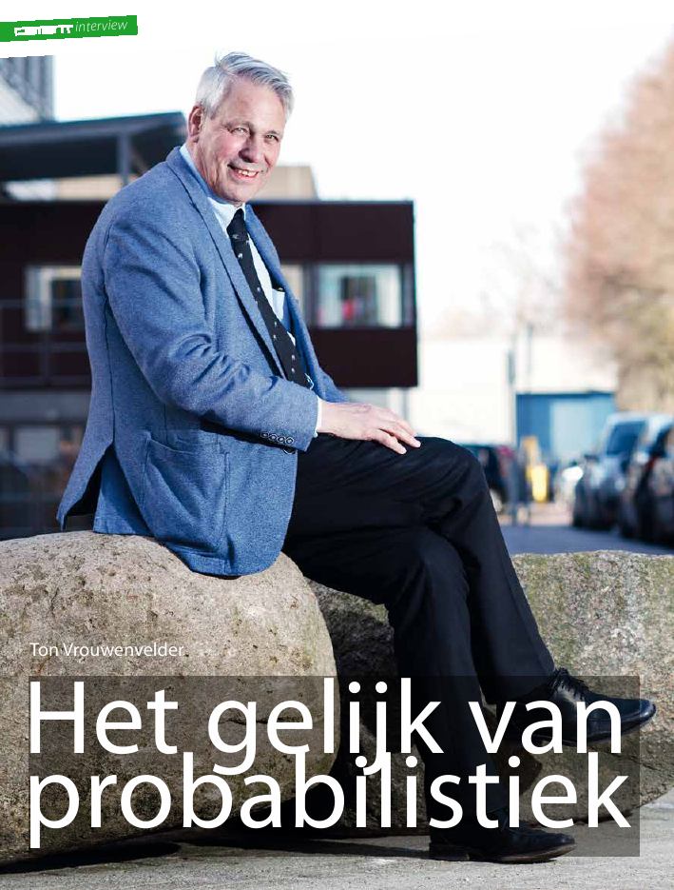
Structural mechanics
Dynamics of Structures
Professors
Andrei Metrikine
Karel van Dalen
Eliz-Mari Lourens
Apostolos Tsouvalas
Ton Vrouwenvelder

Slide 4
Structural mechanics
Dynamics of Structures
Courses
CIE4140 Dynamics of Structures
Focus:
Fundamentals of the Dynamics of Structures

Slide 5
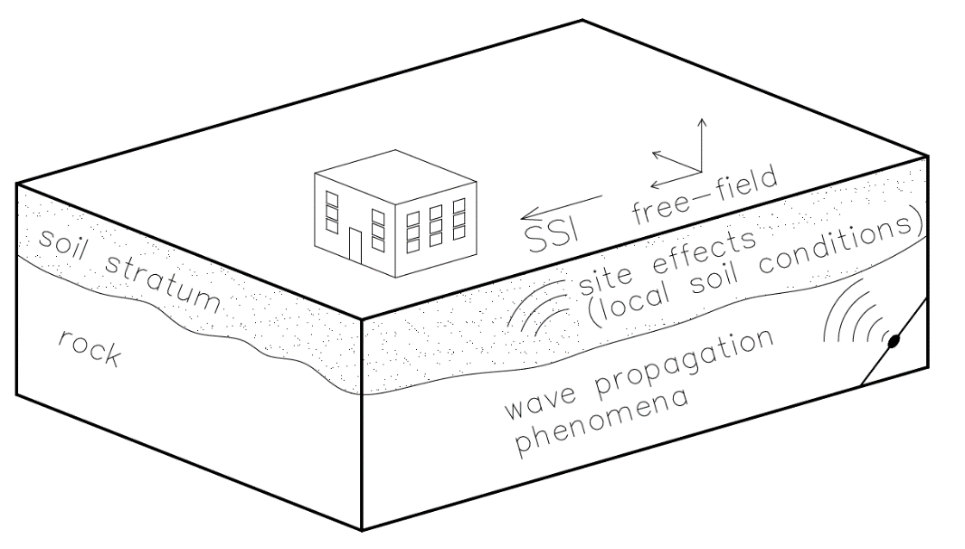
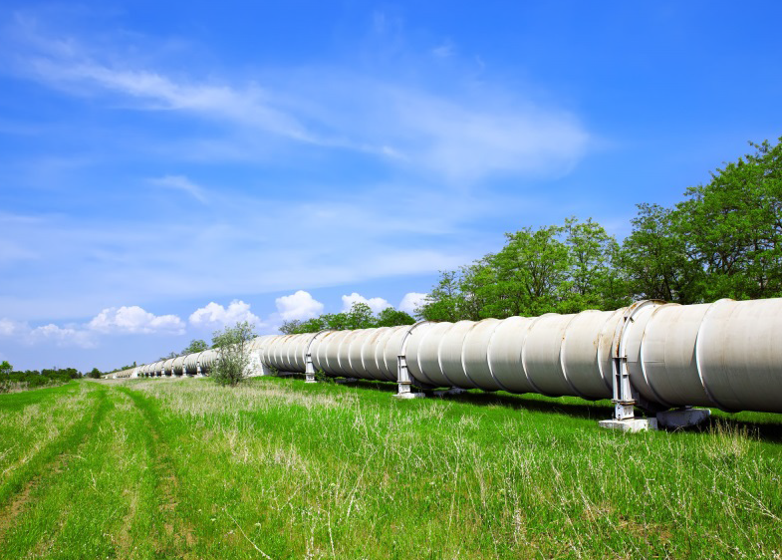
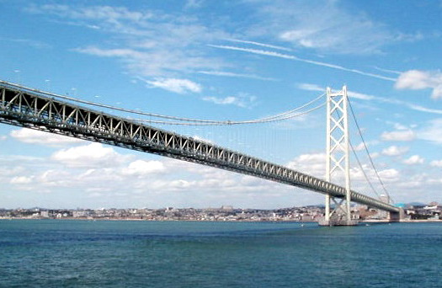
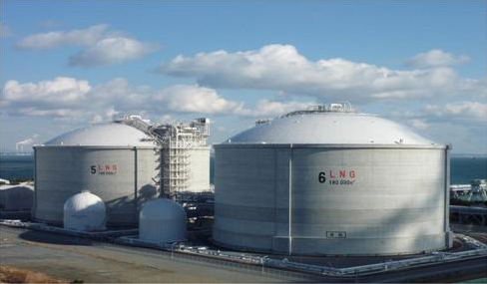
Structural mechanics
Dynamics of Structures
Courses
CIE5260 Structural response to earthquakes
Focus:
Response of structures to both tectonic and human-provoked earthquakes

Slide 6
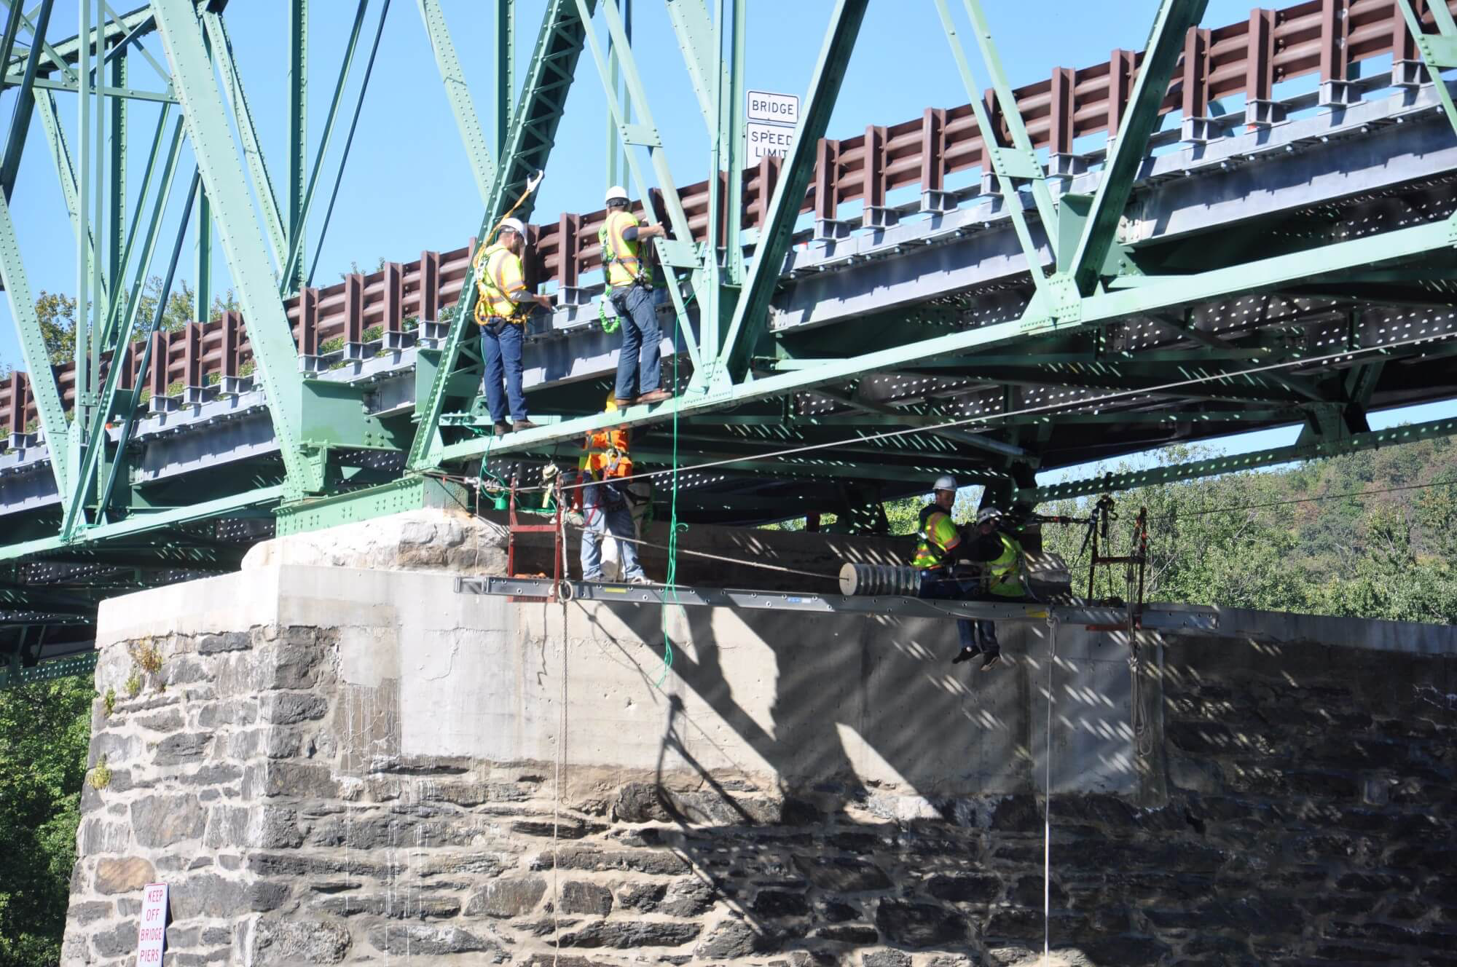
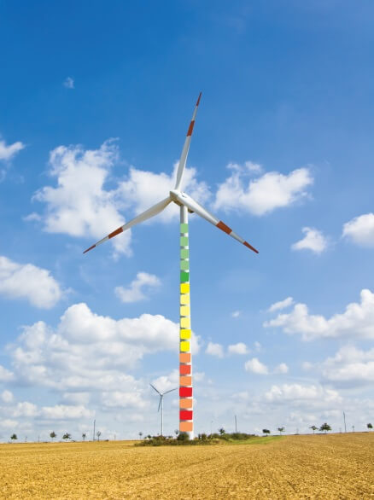
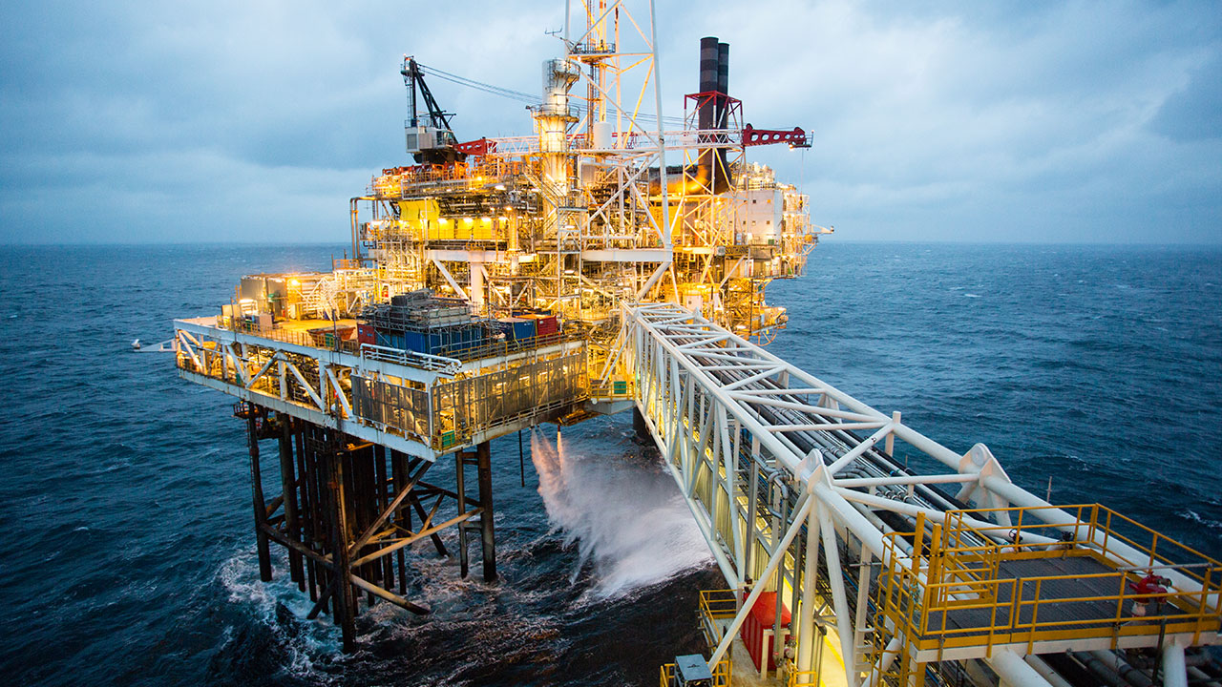
Structural mechanics
Dynamics of Structures
Courses
OE44055 Load Identification and Monitoring of Structures
Focus:
Identification of loads and structural heals from measured accelerations and strains

Slide 7
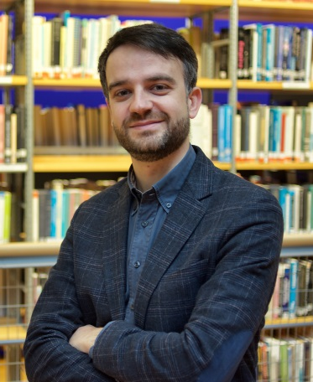
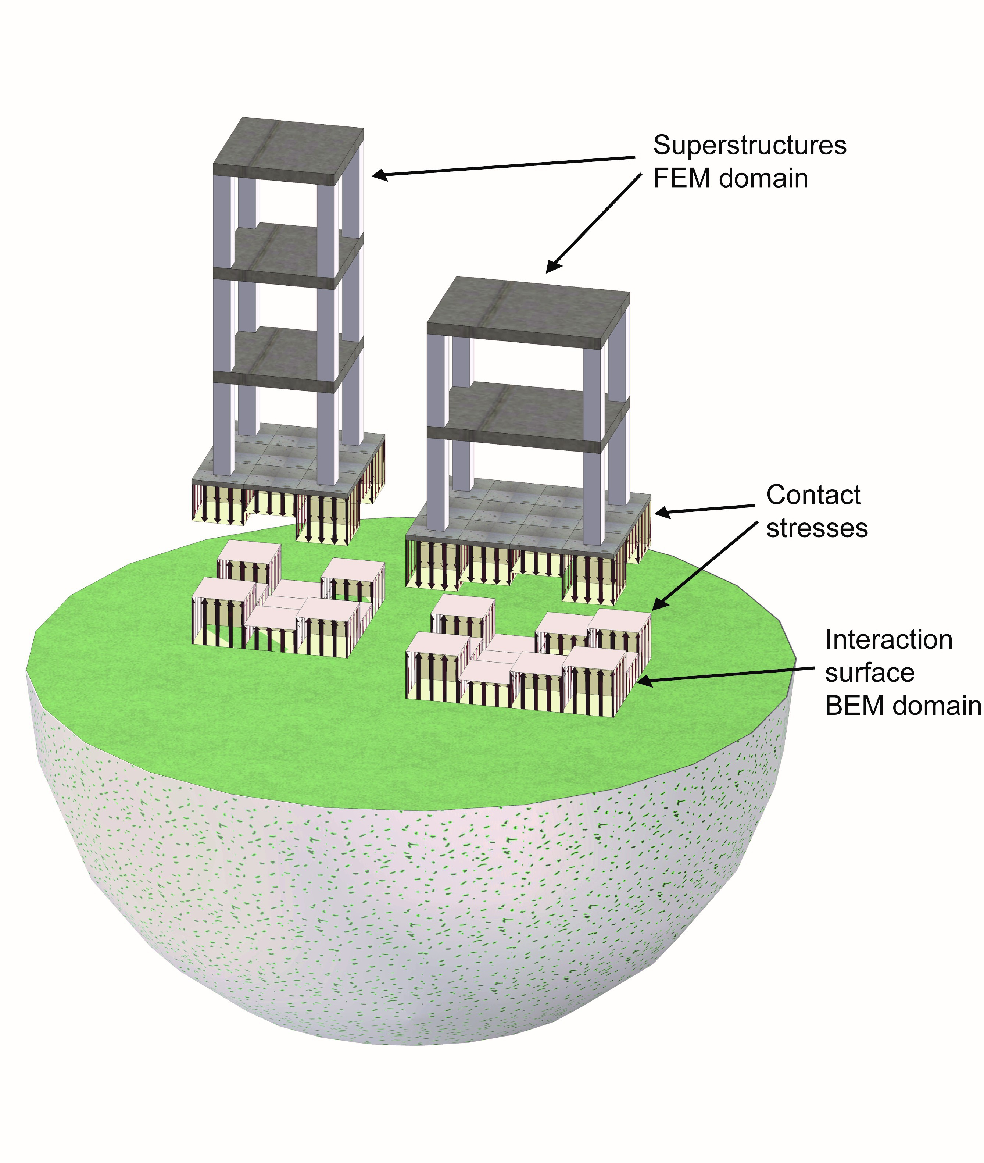
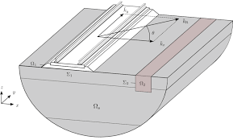
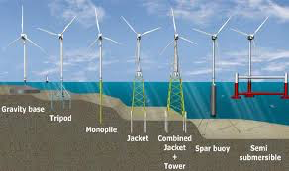
Structural mechanics
Dynamics of Structures
Courses
CIE5340 Soil Dynamics
Focus:
Effect of soil-structure interaction on the dynamics of structures

Slide 8
Structural mechanics
Dynamics of Structures
Courses
CIE5145 Random Vibrations
Focus:
Stochastic loading of structures and characterization of their random response

Slide 9
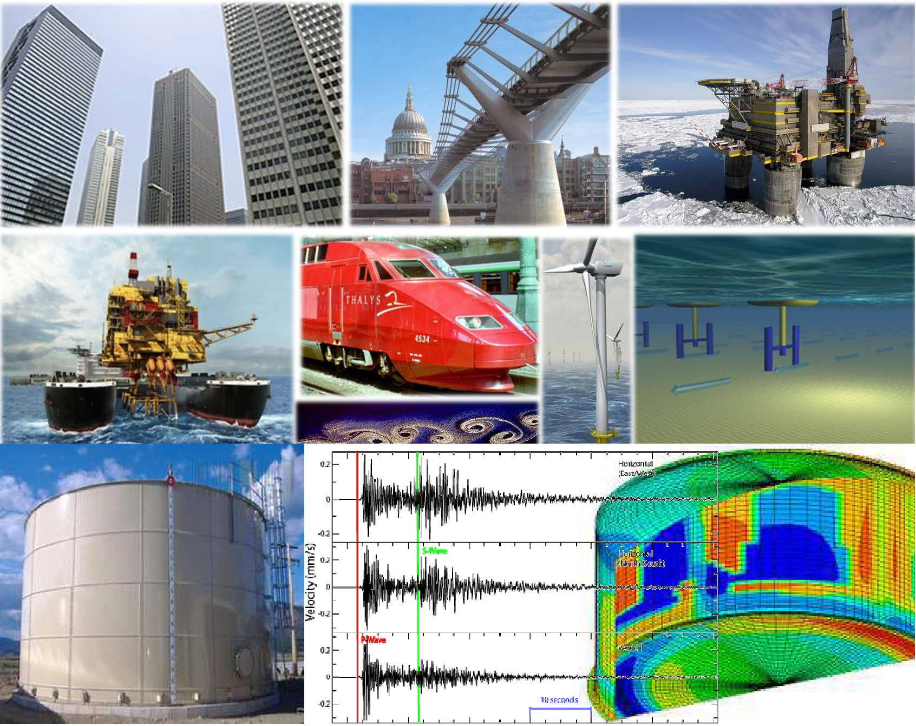
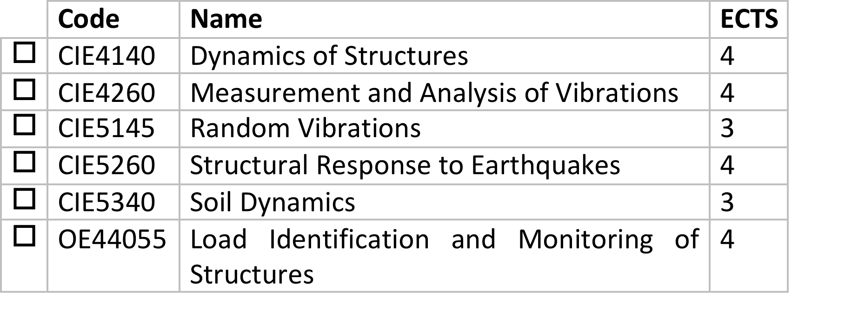
Structural mechanics
Dynamics of Structures
Annotation Dynamics of Structures
If all courses of an annotation are taken and the topic of the graduation thesis is associated with the annotation, a TU Delft certificate is issued confirming in-depth knowledge in the subject matter of the annotation.

Slide 10
Structural mechanics
Dynamics of Structures
Modus Operandi
Intensive education into the fundamentals and application of the theory associated with dynamics of structures;
Personal approach by means of discussion with every student of the best collection of electives;
Assistance with finding an interesting graduation topic in a company.
Execution of the MSc thesis in close co-operation with a relevant company or within an ongoing at the TU challenging project (see examples of past projects at http://homepage.tudelft.nl/v5u5c/ )

Slide 11
Structural mechanics
Chair Dynamics of Structures
Many thanks for your attention and welcome to our group!

